Slide 1
MEMBERSHIP UPDATES

Slide 3
MEMBERSHIP OPPORTUNITIES
20% of all districts have not charted a new club in the last 5 years
34% of membership leads are not followed-up on by district leadership
Over 10% of new members leave within the same year of joining
Approximately 50% of all terminations are members for less than 3 years

Slide 5
THE CLUB EXPERIENCE
matters most.

Slide 6
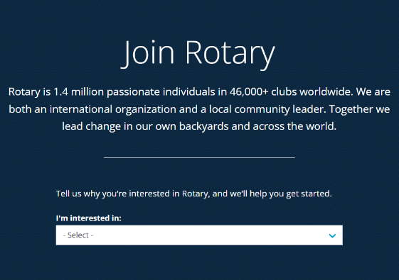
MEMBERSHIP LEADS
20,000+ per year (Rotary)
10,000+ per year (Rotaract)
61% under 40
35% female
66% followed up by district
10.6% conversion rate
rotary.org/join

Slide 7
rotary.org/start-club

Slide 8
MEMBER ATTRITION
10%
50% LEAVE WITHIN
3 YEARS OR LESS
LEAVE WITHIN
THE SAME YEAR

Slide 9
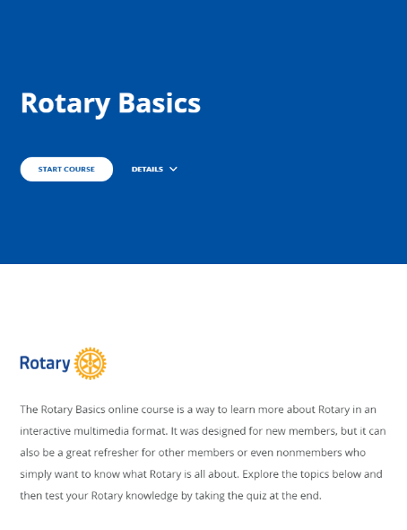
rotary.org/membership
rotary.org/learn

Slide 10
NEW MEMBER ENGAGEMENT CAMPAIGN

Slide 11
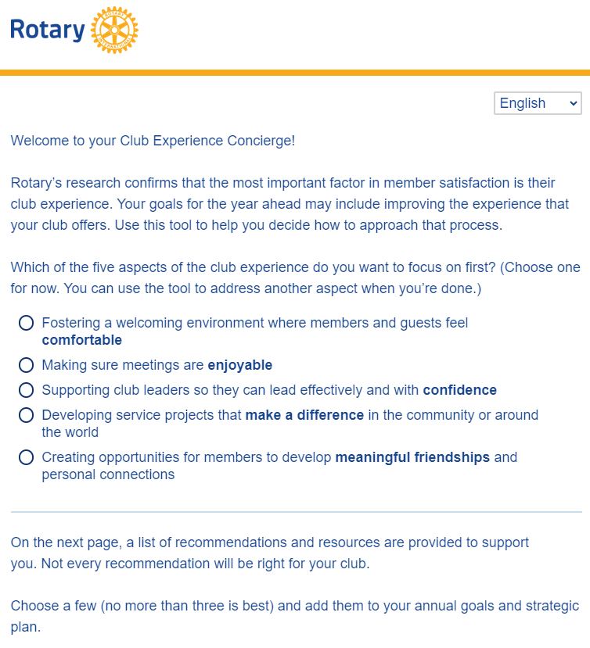
rotary.org/membership

Slide 12
Second Session
rotary.org/membership

Slide 13
QUESTIONS

